Slide 1
Client/server applications in C#
By Caleb Ellis

Slide 2
THE IDEA
At first, I set my sights on developing a simple TCP/IP Chat Client and server based off of IMS (Instant Messaging Services).
What I wanted was a interface where someone could create a server and clients could easily connect to that server.
But then I realized that the project was much more than, I could adapt/modularize the server code to make it any type of server that I wanted. In the end it worked out more like a platform for managing different servers. This was I could develop different types of servers and use the server application to start/stop and configure them.
The project is still in a primordial state, therefore server applications are executed by plugging what could be regarded as server modules. I am in the process of optimizing it.

Slide 3
THE PROJECT
The project in its current state utilizes the following technologies:
C#.net
WPF (Windows Presentation Foundation)
Python
Socket Programming
The Project is current floating around 1700 lines of code (90% c# , 10% python) but as I said, I still have to do some optimizations.

Slide 4
C#/WPF
I used C# for the following components of the project:
Server Core
Original Client GUI (Chat)
Original Client Command line (Chat)
I used WPF for the follow component of the project:
Original Client GUI (Chat)

Slide 5
PYTHON
I used Python for the following components of the project:
  File Client application
  File Server Module
  The project utilizes the IronPython library which allows python interlope with .net.

Slide 6
HOW THE SERVER WORKS
The Server is built on a command system that can be extended. The start command is used to start new servers and is the part that allows different types of applications/code to be invoked based off the server.
The server waits for a connection and when one is established, it waits until the connection send something. The server parse the values and sends back based off depending what the server does.

Slide 7
SOCKETS: SERVER SIDE
Sockets are what are used to programmatically send data between software and ultimately between two computers. A socket is represented by an IP and a port number.
Example Socket: 192.168.1.1:8080
We start by creating a socket that will act as a listener. This listener is what waits for incoming connections.
To create the listener you need the following:
The servers IP address
The port number the server will be using
these both represent the Local Endpoint which represents where incoming data is going.

Slide 8
SOCKETS: SERVER SIDE (CONT.)
After the listener is created we need to bind the listener to the endpoint.
Once we bind the listener (to the local endpoint), we can simply start listening for inbound connections by initializing it with a backlog.
The backlog is what defines how many connections the server can maintain at any given time.
In order to parse the data that a client sends, we create a new socket that is usually named handler. The handler is the result of a listener accepting a connection.
From there the handler maintains the connection between a Remote Endpoint.
We wrap this action of receiving in an infinite loop so that the client can continually send data and we break out when the client is done.

Slide 9
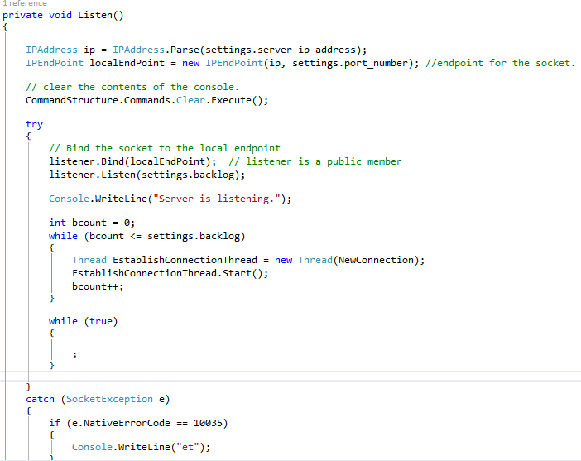
SERVER: LISTEN METHOD
Create and bind the socket and then start listening, starting threads (based on the value for the back log) until they are all created and then start an infinite loop to stop the mean thread.

Slide 10
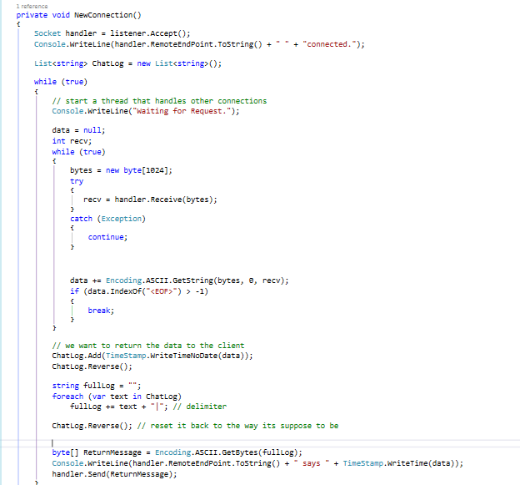
SERVER: NEW CONNECTION METHOD
Accepts a new connection and then waits
To receive something from the connection.
It then parses the data, writes to the server
Log/console and then sends it back to the
User with a time stamp.

Slide 11
SOCKET: CLIENT SIDE
The Client socket programming is pretty simple in comparison to the server.
We start of by defining a socket that is usually named “sender”, this socket is what connects to a remote end point and is used to send data.
This time, we need to establish a connection to a remote endpoint so instead we use the servers IP address and port number that it is using. This time, were not binding the socket, but rather connecting to the remote end point.
After connecting, we can send data to the server and wait for a reply. Once we receive a reply we can parse the data that it returned and do what we need for it. We don’t always have to wait for a reply though, we can keep sending or do whatever we want.

Slide 12
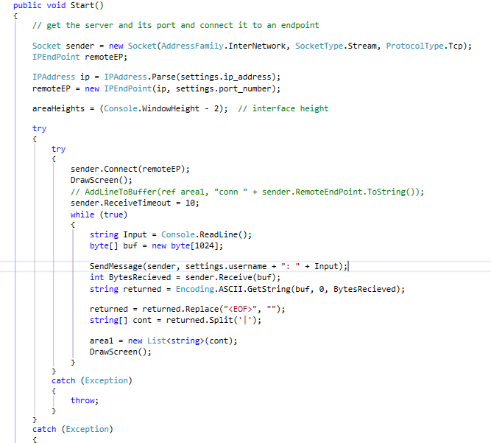
CLIENT: START METHOD
Create the socket and endpoint. The we connect to the remote endpoint. Once we have sent and received data, we parse it and then draw it on the screen.

Slide 13
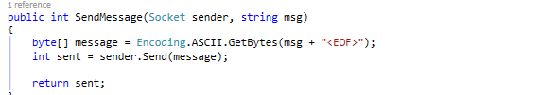
CLIENT: SEND MESSAGE METHOD
Sends a message to a remote endpoint and returns the number of bytes that are being sent.

Slide 14
THREADING
Multithreading is the act of a program using multiple asynchronous during application execution. Essentially this means that we can call same or different functions at the same time.
I used multithreading in this application so that the server can maintain multiple new connections.

Slide 15
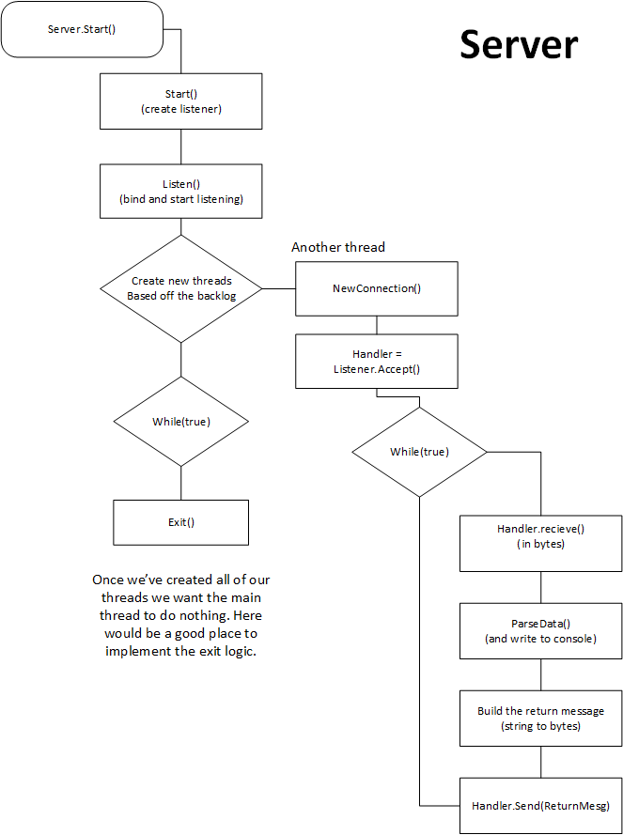
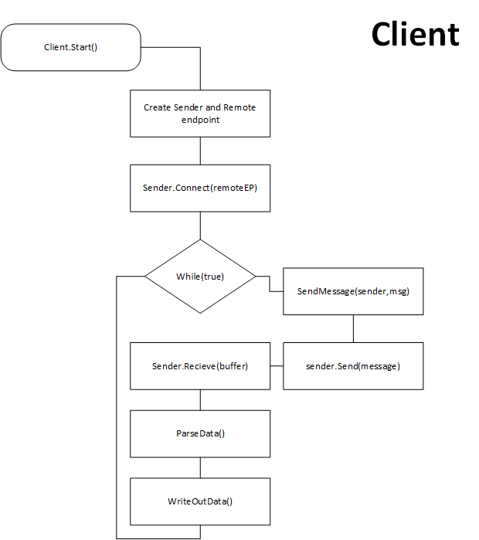

Slide 16
MODULARITY
The Project in its current state is what I would call “pseudo-modularity”. Most of its moving parts are separate and all of the components that act as a server/client can be loaded in. The main problem is that most of the different project components don’t work / don’t make sense without each other. Normally, with object oriented programming, you want to have each class separate and contrived so that don’t rely on each other, but rather work in use of each other and are able to be adapted into something else later.
For example:
ServerList.cs primary function is to manage (add,delete,list,etc.) server names and configuration file locations. But ServerList.cs needs to use instances of the class ServerInit.cs (which deals with the creation of servers) for different properties or methods. Instead it would be better if these two worked separately and the things that ServerList.cs needs to do with ServerInit.cs would be done in ServerInit.cs (and vice versa).

Slide 17
Command system
Each command is represented by a class and implements the Interface named ICommand.cs
An interface defines a guideline classes that inherit it so that they implement and include the members of that interface. They're good for putting together plug-n-play classes and grouping like classes. Classes can also be constructed from interfaces so I can use its interfaces as a argument to a method and pass in any class that implements that interface.
Currently, I am only using this Interface as a guideline for my classes but I would like to use them to dynamically access commands.

Slide 18
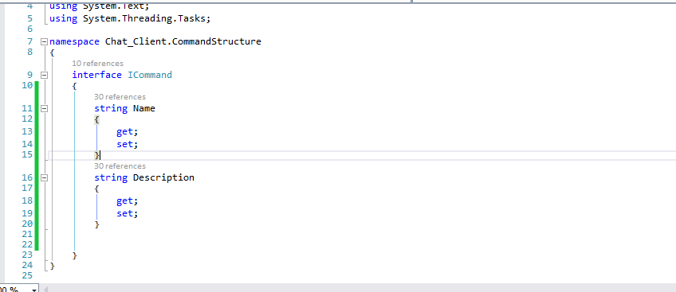
ICOMMAND.CS

Slide 19
COMMANDS
The server includes the following commands:
clear - Clears the buffer of any text. : Alias = cls
create - starts the creation dialog for a new server : Alias = None
delete - deletes a server by name : Alias = rm
exit - closes out of the application : Alias = None
help - displays info about commands : Alias = None
ping - does a simple to a specified address : Alias = None
Slist – show a list of servers being used : Alias = ls
start – starts a server by name : Alias = None
View – Show the configuration of the server : Alias = None
Alias – Show all alias’s : Alias = None

Slide 20
COMMAND EXPLANATIONS
I wanted to create a system where someone could create and save server settings and access them later. Most of the other commands are supplements to that idea (slist so I can view the servers I’m working with, view to look at the configurations)
While I was going along I decide to make several commands to help myself, like alias and ping. I just wanted to be able to use the ping command in program itself so I re-implimented it. The alias command is just there to help me remember command alias and would probably be removed in a shippable version.

Slide 21
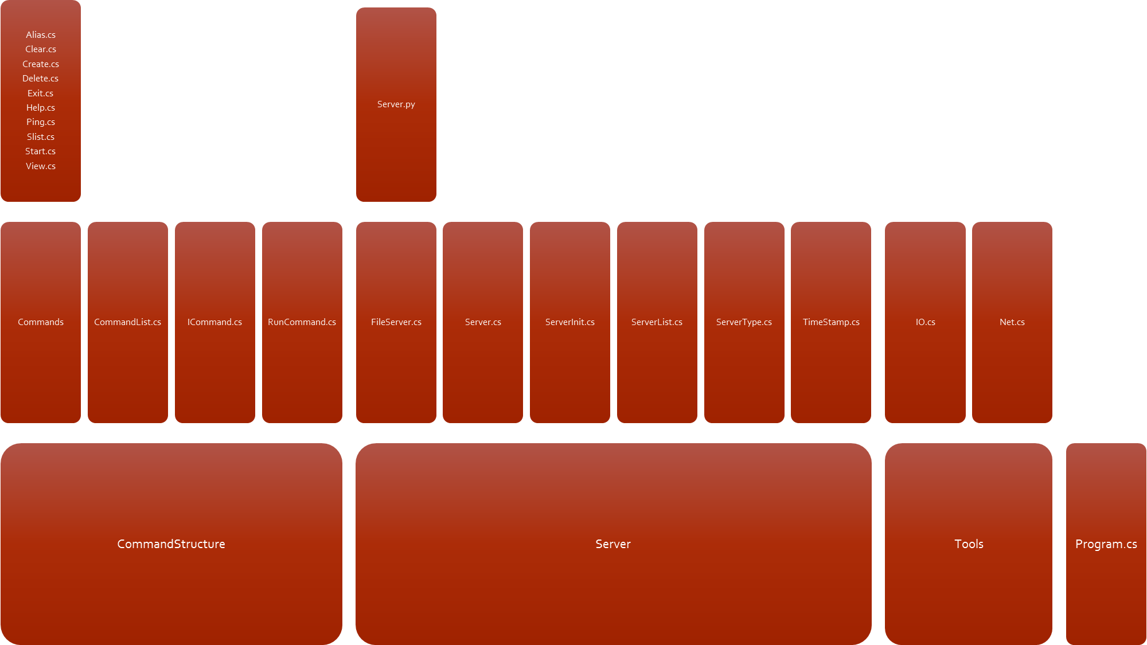
SERVER STRUCTURE

Slide 22
CLIENT EXAMPLES
Currently I have two examples for Client and Server Interaction.
The first is my unfinished chat client/server. The barebones logic of this is complete but there are several problems with it, that I will go over later.
The other example is a “dumb” file transfer client/server that mimics tftp.

Slide 23
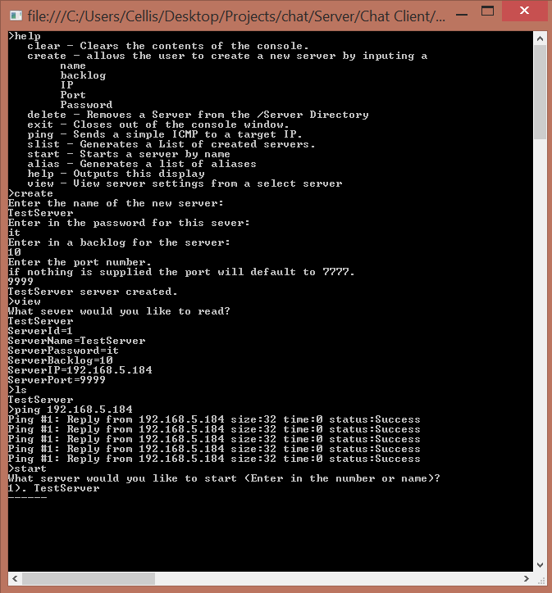
EXAMPLE: CHAT SEVER
Test of a few commands and creating a server.

Slide 24
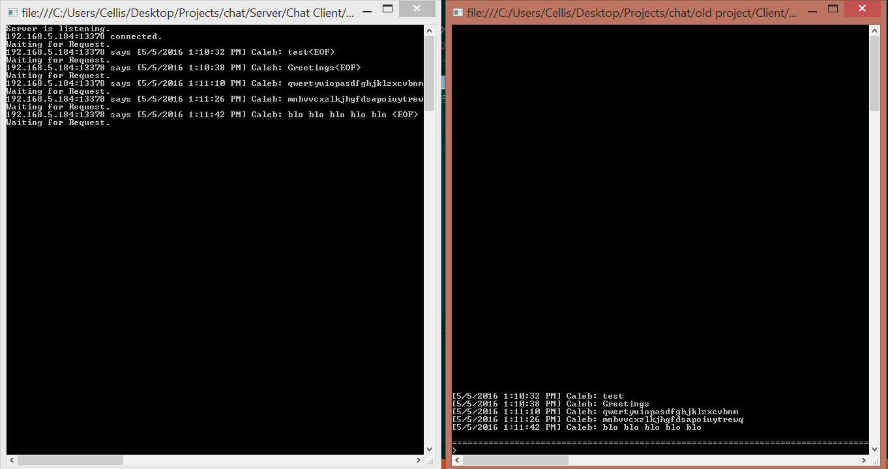
Example: Chat client/server

Slide 25
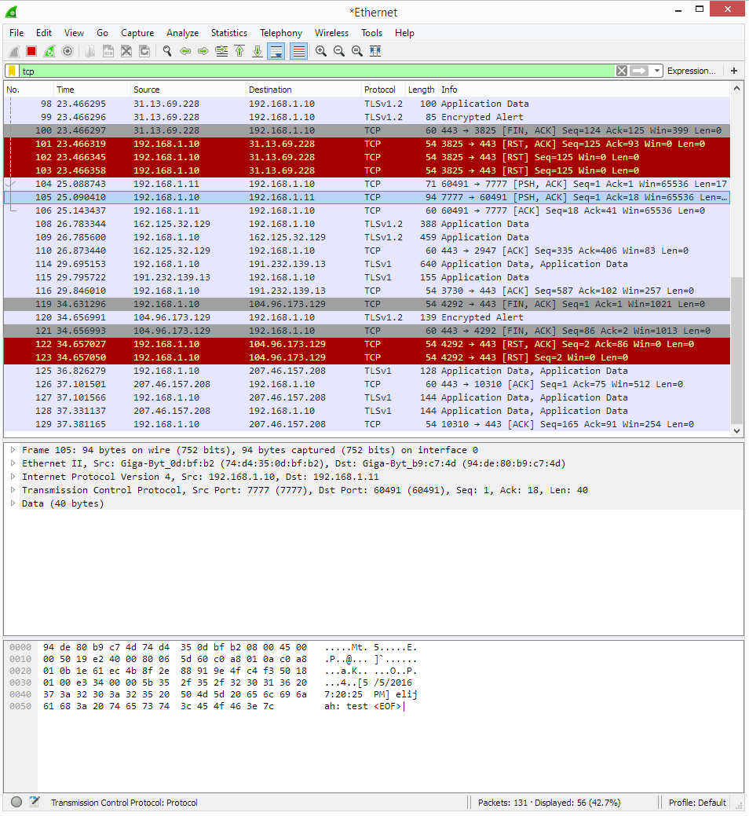
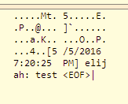
192.168.1.10 – Server
192.168.1.11 - Client

Slide 26
WHAT WENT WRONG WITH THE CHAT CLIENT
The original project was built around this idea but I ran into a couple road blocks.
The Server was not built asynchronously, so while I could maintain multiple connections with the use of threading, it was impossible to update a single client about the information that another client was sending.
In other words, the server could maintain multiple connections, but the clients wouldn’t be able to share information between each other.
If the client was adapted to handle connections asynchronously, it would probably work but the implementation is difficult and due to time constraints, I moved ahead.

Slide 27
EXAMPLE: FILE CLIENT/SERVER
As an example of modularity, I decided to develop a file client/server as an example of how different server applications can be loaded in and configured.
The file Server is written in Python and is complied using IronPython, which is a .NET extension for python.
Overall, the file server is pretty “dumb”, and by dumb I mean that it doesn’t cover all different file encodings and might get caught of with different files. The server/client doesn’t really care about what is being sent, it only sends it and then gets ready to send/receive another

Slide 28
EXAMPLE: FILE CLIENT/SERVER
After creating a server ( you would create it as a file server but its only possible to start it as a file server unless its specified programmatically because I have yet to implement the code that lets the user choose what type of server they want to create), the applications invokes a python script and passes in arguments from C# to Python to initialize the server.
After the listener is binded, it waits for a client to connect.
Once the Client connects, it waits to receive something from the client. The way that the Client is set up is that the next thing that the server will receive is a command.
There are three simple commands for the file server: GET, PUSH, LIST

Slide 29
EXAMPLE: FILE CLIENT/SERVER
When the server receives a PUT command, it waits to receive the name of the file. The server decodes the incoming bytes and determines the file name and extension and then again waits to receive the file itself. The Server knows when to stop receiving when it gets a STOP code, which is something that the client sends to tell the server to wait for another command
When the server receives a LIST command, it simply sends the result of the python method os.listdir() (each appends with an new line).
When the server receives a GET command, it waits for a filename or path to be send, looks for that file and then sends it, while the client decodes the message and waits for a stop code.

Slide 30
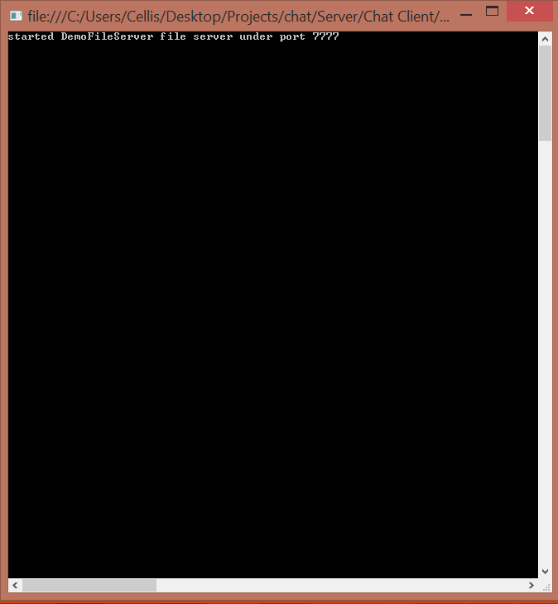
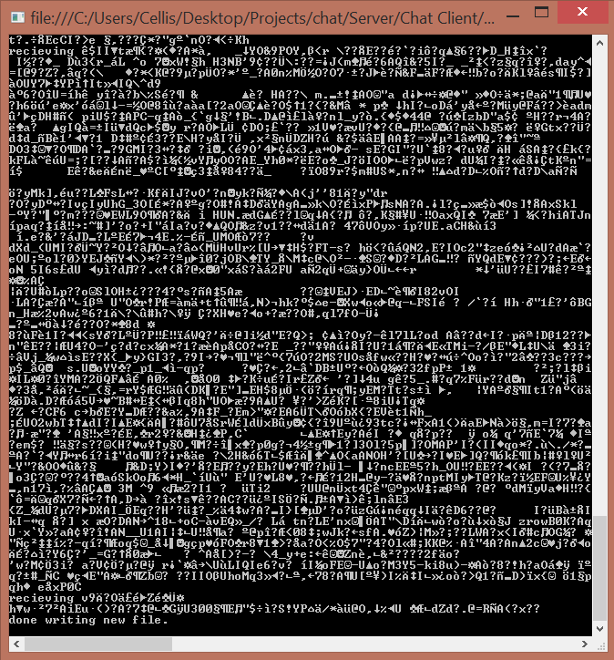
1
2
Receiving cat.jpg ->

Slide 31

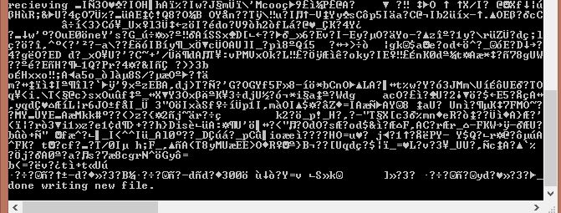
EXAMPLE: FILE CLIENT/SERVER
Receiving Test.txt
Receiving fireworks.webm

Slide 32
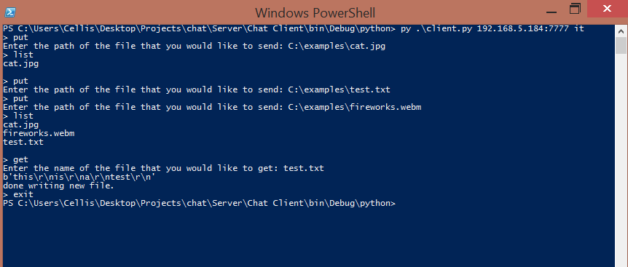
EXAMPLE: FILE CLIENT/SERVER

Slide 33
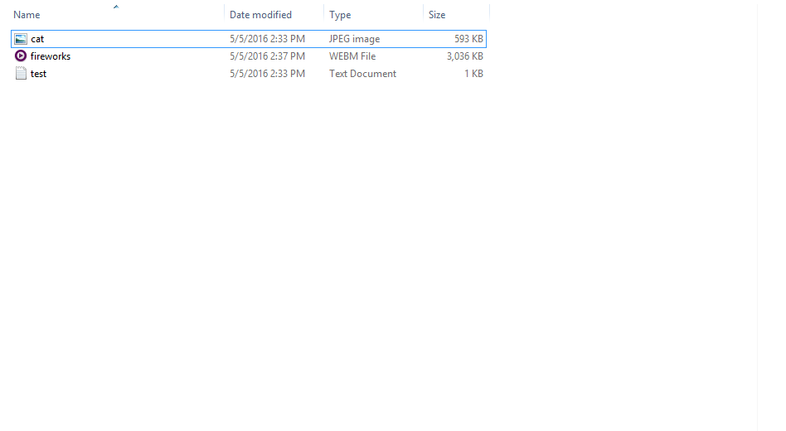
EXAMPLE: FILE CLIENT/SERVER

Slide 34
WHAT I APPLIED/LEARNED FROM THE PROJECT
Reinforcement of advanced Object Oriented Principles and Designs
Creating Exceptions in C#
Creating Events in C#
Socket Programming in C# and Python
Creating a Command system / REPL in C# and python
Creating a basic GUI in WPF
Directory manipulation in C#
Passing data between forms in WPF
Using System.Net / socket (python library)
Structuring a medium sized project

Slide 35
WHAT I APPLIED/LEARNED FROM THE PROJECT (CONT.)
Interfaces in C#
Using IronPython
Invoking Python scripts with aruguments in C#
Enums in C#
Threading in C# and Python
Encoding and Decoding in Python
Sending and Receiving files in Python
The joys and wonders of trying to decode a utf-16 file in utf-8

Slide 36
WHAT’S NEXT
Moving ahead with this project I’ll start by looking at the server core and cutting back on some classes reliance on other classes. The project might have some unnecessary lines of code and I think I could probably go back and refactor them. From there I would like to implement a more dynamic command system that uses ICommand.cs more thoroughly. Another thing that I would like to do is fix the Chat client because I would love to see how it would work. The file client/server needs some error checking to be done, but it mainly serves as an example. Finally I would like to create more examples to test the limits of the application.

Slide 37
HOW I DEVELOPED THIS PROJECT
Tools:
Visual Studio 2013 – C#/WPF
Emacs – Python
Wireshark – Diagnostics
Git – Version Control (via https://github.com/ )
I mainly worked on this project when I had spare time or felt like it, this means I didn’t follow any development process to complete it.

Slide 38
OTHER THINGS I’VE GOTTEN OUT OF THIS PROJECT
IP to location calculator in C#.
A Graphing program that graphs ping statistics in C# and R.
A clone of “A Dark Room” in Python.
A multilayer deep learning neural network perceptron in Python, R and C#. (2)
A browser session transfer in Python (uses sockets. Yay.).
A reddit image downloader in Python.
A Imgur album/image downloader in Python.
An OldSchool RuneScape Grand Exchange price API in Python.
YouTube playlist amalgamator in Python, HTML/CSS.
Dozens of Scripts written in Python, Haskell and Emacs Lisp.

Slide 39
THAT’S IT
The link to the source
https://github.com/Blankpanda/chat_client

